Slide 1
CS 2212
Introduction to Software Engineering
Chapter 15 Quality Concepts

Slide 2
Copyright Notice This Presentation and Its Associated Video Contain Copyright Material. This Presentation and Its Associated Video Are Provided for Teaching Purposes of CS2212 and Should Not Be Posted In Any External Site, Or Shared with. This Presentation and Its Associated Video Are Provided For Instructional Personal Use Only, and Only For The Purposes of the CS2212 Course.

Slide 3
Part 44
The Concept of Software Reliability and Availability
You can't manage what you can't measure.
― Peter Druckerhen.
Notes:
This lesson introduces the basic steps in a software engineering project at a high level.
In practice, steps often overlap.

Slide 4
Learning Objectives in this Part
To understand the concepts of Software Reliability and Availability

Slide 5
Software Reliability
What Is Software Reliability?
Defn.: Probability of failure-free op, specified time, given environment
Affected by development process—not ageing
Uses
Criterion for technology evaluation: expensive
Project management: ready to release? More test?
Size of change: change decreases reliability

Slide 6
Basic Concepts
Failure and fault
Failure: departure of external results of program operation
Fault: cause of failure (localized or not)
Time
Execution time (τ)
Calendar time (t): meaningful to managers
Characterizing failure occurrence in time
Time of failure: instant
Time interval between failures
Cumulative failures up to a given time
Failures in a time interval

Slide 7
Terminology
It is in the code... (bug)
Fault
May cause
The system goes into an
internal state different than
specified
Error
May cause
It is observed
Failure

Slide 8
Reliability and Availability
A simple measure of reliability is:
MTBF = MTTF + MTTR, where
MTBF Total average time between two consecutive failures
MTTF Average time between two consecutive failures
MTTR Average time to repair a fault
MTBF is a better reliability estimator than “faults/KLOC”

Slide 9
Reliability and Availability
Availability is defined as the probability that the system will behave according to its specifications when it is requested to operate at a certain point in time.
In general, the metric of availability is also a better estimator of the maintenability of a system than the MTTR metric

Slide 10
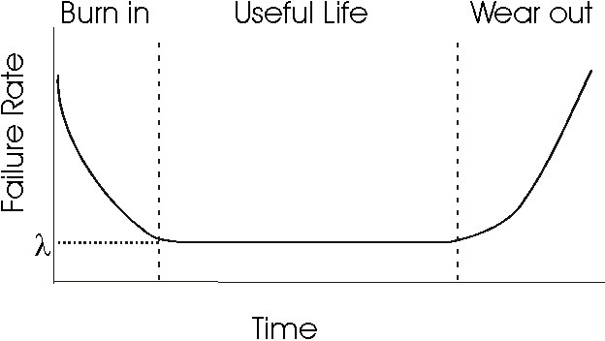
Failure Intensity in “Physical” systems and structures
http://www.ece.cmu.edu/~koopman/des_s99/sw_reliability/

Slide 11
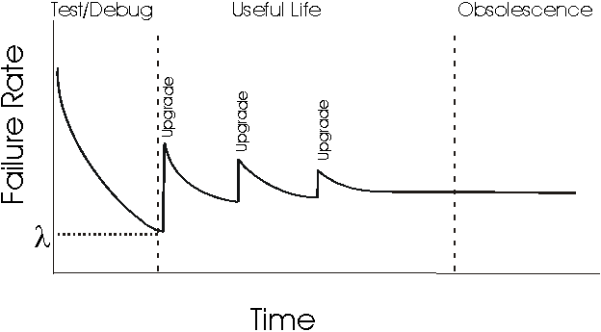
Failure Intensity in Software Systems
http://www.ece.cmu.edu/~koopman/des_s99/sw_reliability/

Slide 12
Part 45
Software Reliability Growth Models
A program that produces incorrect results twice as fast is infinitely slower.
― John Osterhouthen.
Notes:
This lesson introduces the basic steps in a software engineering project at a high level.
In practice, steps often overlap.

Slide 13
Learning Objectives in this Part
To learn how to estimate software reliability using reliability Growth Models

Slide 14
Methodologies for Calculating Software Reliability
The most well-known models / methodologies for calculating reliability of software systems fall into two main groups:
Error Seeding Models
Growth reliability models
Error seeding - It is a method of calculating the number of defects found in the code. In this methodology defects fall into two categories - those in the code and those we deliberately put (and of course we know how many are). The number of defects found in the code is calculated by the (assumed stable) ratio of the number of the two types of defects as they are discovered during the system test.

Slide 15
Reliability Growth Models
Reliability Growth Models
These models calculate the improvement of a system's reliability, as defects are discovered and corrected as a result of the testing process, using a growth function.
The free variable (input variables) is time and the bound variables (result) are reliability, the system failure rate, or the cumulative number of defects that have been detected up to a point in time

Slide 16
Reliability Measurements in Reliability Growth Models
A typical measurement to calculate the reliability of a system (number of failures in the time unit) is the rate of failure defined by:
where τ = CPU time (in a multitasking machine), or real time in an embedded system).

Slide 17
Reliability Models (of Musa)
Assumptions
Two models
Basic
Logarithmic
Diff: Change in failure intensity per failure seen
Basic: decrement is constant
Logarithmic: decrement reduces

Slide 18
Basic Assumptions
Faults are independent.
Execution time between failures is large with respect to instruction execution time.
Potential ‘test space’ covers its ‘use space’.
Inputs per test run (test or operational) are randomly selected.
All failures are observed.
The error causing the failure is immediately fixed or else its re-occurrence is not counted again.

Slide 19
Reliability Models
Basic model
Logarithmic model
λ(μ) = λ₀[1 - μ/v₀]
λ(μ) = λ₀exp(−θμ)
θ: failure intensity decay
Initial failure intensity, λ₀
λ: failure intensity
Basic
Log.
v₀
λ: pronounced lamda
θ: pronounced theta
μ: Mean failures exp.

Slide 20
Reliability Models
Basic model
Logarithmic model
μ(τ) = v₀[1 – exp(−λ₀τ/v₀)]
μ(τ) = (1/θ).ln(λ₀θτ + 1)
λ(τ) = λ₀exp(−λ₀τ/v₀)
λ(τ) = λ₀/(λ₀θτ + 1)
λ
μ
Log.
Log.
v₀
Basic
Basic
τ
τ

Slide 21
Reliability and Failure Intensity
Reliability R and Failure Intensity λ are related by the equation:
R(τ) = exp( −λτ)
As expected, the probability that we will not observe a failure on a given time (reliability), is lower for larger system operation time intervals

Slide 22
Musa’s Basic Model
Failure Intensity - (FI) is defined as the number of failures in the unit of time.
The Musa’s Basic Model considers that the rate of reduction of the Fault Intensity (derivative in relation to the total number of faults μ), is constant.
This means that Fault Intensity is a linear function of the average total number of failures we have observed up to a certain time (CPU time or calendar time).
Reference: Musa, Iannino, Okumoto, “Software Reliability: Measurement, Prediction, Application”, McGraw-Hill, 1987.

Slide 23
Musa’s Basic Model
In the Basic model failure intensity is defined as:
Where λ₀ is the Failure intensity at the initial at the start of the system (before any defect correction is made)
μ is the (average) total number of failures up to a certain time
v₀ is the total number of failures we expect to have in the unlimited run time of the program. Also:

Slide 24
Example
Let's assume that a program will have 100 failures throughout its lifetime (v₀), and that so far we have noticed 50 failures (μ), and that the initial failure rate is 10 failures per CPU hour (λ₀).
Then the estimated present failure intensity using the basic model is:
The (average) total number of failures after 10 cpu hours will be:
And for 100 CPU hours of operation

Slide 25
Musa’s Logarithmic Model
The rate by which the failure intensity drops is getting lower, as defects in the code are discovered and corrected
In this model
λ(μ) = λ₀ e^{(-θμ)}
where θ is a Faιlure Intensity reduction parameters
Accordingly, the (average) total number of failures at a time t is:

Slide 26
Example: Let us assume λ₀ = 10 failures/cpu hour, θ = 0.02/failure, and that up until now we have observed 50 failures.
Then:
In 10 cpu hours:
(less total number of
failures than the basic model)
and in 100 cpu hours:
(more total number of
failures than the basic model)

Slide 27
Example Use of Reliability Models
Example: Assume that a program will experience 100 failures in infinite time.
The initial failure intensity was 10 failures/CPU-hr, the
present failure intensity is 3.68 failures/CPU-hour and our
objective intensity is 0.000454 failure/CPU-hr.
Predict the additional testing time to achieve the stated objective using Musa’s basic model.
Ans.: We know that λ(τ) = λ₀exp(−λ₀τ/v₀)
At time τ₁, λ(τ₁) = λ₀exp(−λ₀τ₁/v₀) = λ_{p}
At time τ₂, λ(τ₂) = λ₀exp(−λ₀τ₂/v₀) = λ_{f}
τ₂ - τ₁ = (v₀/ λ₀).ln(λ_{p}/ λ_{f})
v₀ = 100 faults, λ₀ = 10 failures/CPU-hr
λ_{p} = 3.68 failures/CPU-hr, λ_{f} = 0.000454 failure/CPU-hr
Τesting time = (τ₂ - τ₁ ) = 90 CPU-hr

Slide 28
Operational Phase of the System
When the system goes into its released phase, and there is no change in the code, the failure intensity remains constant.
Both models we have seen will follow a Poisson process with the Reliability Intensity parameter λ to calculate the reliability of the system.

Slide 29
Software Reliability (Parallel Systems)
Let us assume that we have Q_{P}-many subsystems / components each with a fixed failure intensity, and their reliability is calculated in a common calendar time. We also assume that for the system to work properly, all (parallel) subsystems should work properly. Then the Total Failure Intensity is:
Where λ_{k} is the failure intensity of each subsystem.

Slide 30
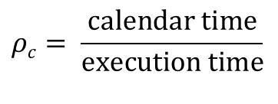
System Operation in Calendar Time
The calendar time of system operation is computed by knowing the ratio:
$$ρc= \frac{\text{calendar} \text{time}}{\text{execution} \text{time}}$$
and the time of system operation in CPU hours.
Calendar time is useful for generalizing the project plan to deliver the system to its users (e.g., Calculate the date on which we will have reached a certain Failure Intensity value).

Slide 31
System Reliability
As we have seen R(τ) = e^{(−λ}_{τ}^{τ)}.
So in CPU time we have:
If the average usage of the computational resources
In the computer for the specific system is ρ_{c} then:
In calendar time
Therefore in calendar time we have that R(t) = e^{(−λ}_{t}^{t)}

Slide 32
It is also possible in the above models to assume that the system running on the computer 1 having the execution rate r₁, is transferred to the computer 2 having a r₂ execution rate
Then, the failure intensity of the system running in computer 2 is:

Slide 33
In its more complex form, the computation of calendar time is based on the process used for correcting the defects as well as the following parameters:
The available computational resources and;
The rate a resource is used

Slide 34
For example, at the beginning of the testing process, we observe many failures at short intervals between them;
Then, testing stops so that we can first correct the errors in the code
As the testing process proceeds:
The time intervals between to consecutive failures are getting larger
In the mean time the personnel who are assigned to correct errors is not doing something
Here, the testing team creates a “bottleneck”
At the end the computational resources are the key factor that determines the throughput of the whole process.

Slide 35
Part 46
Resource Usage Estimation Models
Correctness is clearly the prime quality. If a system does not do what it is supposed to do, then everything else about it matters little.
― Bertrand Meyer.
Notes:
This lesson introduces the basic steps in a software engineering project at a high level.
In practice, steps often overlap.

Slide 36
Learning Objectives in this Part
To learn how to estimate the utilization of resources (hardware, software, personnel)

Slide 37
Resource Usage
Musa showed that the use of resources is linearly proportional to the running time of the system, and the average total number of failures.
if we consider that the variable χ_{r} denotes the usage of a resource r, then
Where θ_{r} is the time the resource r is used per CPU hour; and μ_{r} is the time the resource r is used per failure

Slide 38
In summary we have:
Resources | Use per CPU hour | Use per failure | Available resources | Resource utilization
Personnel for locating errors
Personnel for fixing errors
Computational resources

Slide 39
Example:
A software testing process runs for 10 CPU hours and recognizes 34 failures. If the testing effort for every hour of system run time (operation) is 5 person hours, and each failure requires 2 person hours to locate the corresponding defect, then.
Then, the total effort for finding the errors is:
= 5(10) + 2(34)
= 118 person hr

Slide 40
Your Turn
Define software reliability.
Provide two examples of use for software reliability growth models.
What are the major differences between Musa’s linear and the logarithmic models? Which one you believe is more “realistic” and why? What are the limitations of the linear model?
Provide an example usage scenario and give the corresponding numbers by using Musas’ resource estimation model. Your example can consider the utilization of computing equipment, human resources, etc. (you may want to see the next Module on Software Reviews – Part 47 – for ideas).
Check-out the content of the following sites:
https://users.ece.cmu.edu/~koopman/des_s99/sw_reliability/
https://ntrs.nasa.gov/citations/19820068865
https://sma.nasa.gov/sma-disciplines/reliability-and-maintainability

